Slide 1
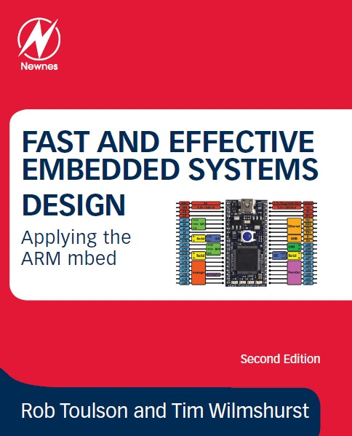
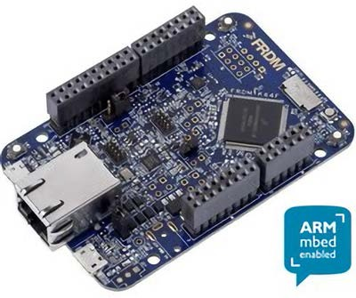
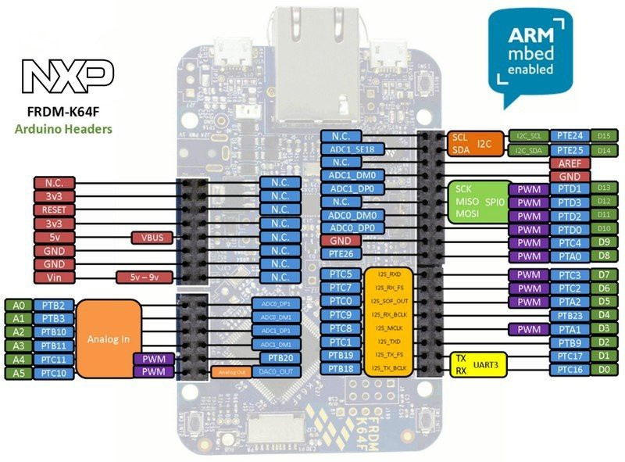
Chapter 11: Wireless Communication
– Bluetooth Low Energy
tw rev. 26.8.16
If you use or reference these slides or the associated textbook, please cite the original authors’ work as follows:
Toulson, R. & Wilmshurst, T. (2016). Fast and Effective Embedded Systems Design - Applying the ARM mbed
(2nd edition), Newnes, Oxford, ISBN: 978-0-08-100880-5.
www.embedded-knowhow.co.uk

Slide 2
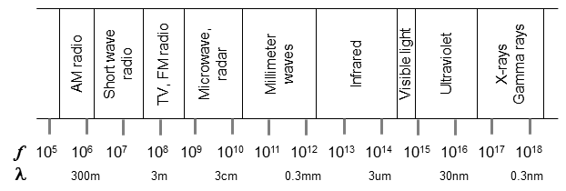
Some Wireless Preliminaries 1
The electromagnetic spectrum shows where various wireless activities sit. Any frequency on the spectrum, from the lowest frequency up to visible light, can be used for data communication. Almost all of this is very strictly regulated by national and international agencies.
The International Telecommunication Union manages the allocation of the radio spectrum between different broadcasters and applications. It reserves certain frequency bands for Industrial, Scientific and Medical (ISM) applications. These are unlicensed, and some vary between countries. The 2.4 GHz band is however reserved for unlicensed use in all regions. It has become widely used, mainly for short-range, low power applications.

Slide 3
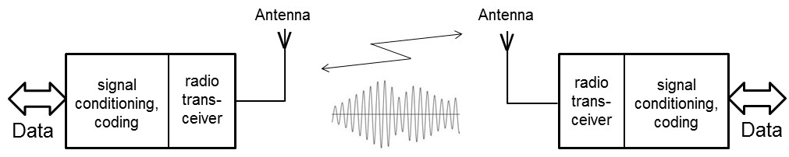
Some Wireless Preliminaries 2
While the spectrum represents the “pure” radio frequencies, they only become useful once they are carrying information. This is done by the process of modulation; the information to be carried is imprinted onto the carrier frequency, through one of a number of different techniques.
One effect of modulation is to cause fluctuations around the base frequency; thus if we say that a certain radio station can be found at the frequency of 103 MHz, in fact it is in a narrow band of frequencies centred on 103 MHz. The word bandwidth is used to define a range of frequencies, for example within which a particular transmission may be taking place.

Slide 4
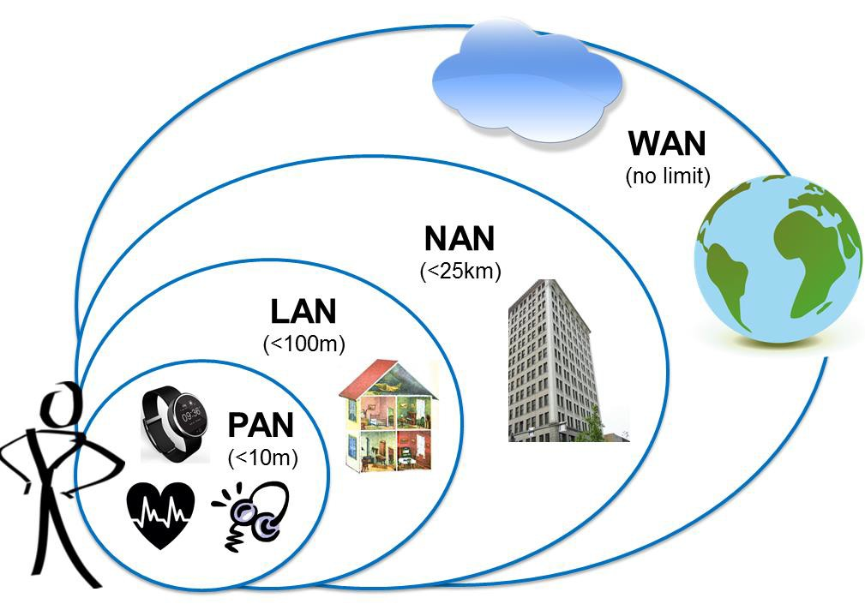
Wireless Networks
Networks can be divided into four categories:
The Personal Area Network (PAN) usually relates to devices close to a person.
The Local Area Network (LAN) typically applies to a single building.
The Neighbourhood Area Network (NAN) could apply to a smart transport or smart energy system.
The Wide Area Network (WAN) includes national or global systems, notably the
Internet.

Slide 5
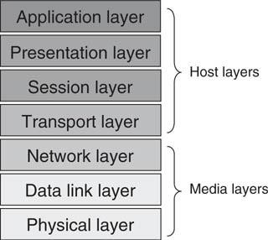
Protocols
With large networked systems, protocols can
become very complicated,
defining every aspect of the communication link. To aid in the process of defining a protocol, the International Organisation for Standardisation (ISO) devised a “protocol for protocols”, called the Open Systems Interconnect (OSI) model, as shown. Each layer of the OSI model provides a defined set of services to the layer above, and each therefore depends on the services of the layer below.

Slide 6
Protocols – IEEE Working Groups
The IEEE (the Institute of Electrical and Electronic Engineers) plays a major role in defining standards and protocols. It maintains a set of standards for Local Area Networks, allocated the number 802. A small number of these which are relevant to this and the next chapter are shown in the Table.
IEEE Working Group | Description
802.3 | Ethernet
802.11 | Wireless LAN, including Wi-Fi
802.15 | Wireless PAN
802.15.1 | Bluetooth
802.15.3 | High-rate wireless PAN
802.15.4 | Low-rate wireless PAN, e.g. Zigbee

Slide 7
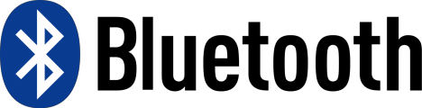
Introducing Bluetooth
Bluetooth is a digital radio protocol, meant for PAN applications, and operating in the 2.4 GHz radio band. It provides wireless data links between devices such as mobile phones, wireless audio headsets, computer interface devices like mice and keyboards, and remote sensors.
There are three Bluetooth classes, based on output power. Class 2 is the most common. The main characteristics are:
The approximate communication range is up to 100 m for Class 1 Bluetooth devices, up to 10 m for Class 2 devices, and 1 m for Class 3.
Bluetooth is relatively low power; devices of Classes 1 to 3 use around 100
mW, 2.5 mW and 1 mW respectively.
Data rates up to 3 Mbps can be achieved. Recent higher data rate versions are being adopted.
Up to 8 devices can be simultaneously linked, in a piconet. A Bluetooth device
can belong to more than one piconet.
Spread-spectrum frequency hopping is applied, with the transmitter changing frequency in a pseudo-random manner 1600 times per second.

Slide 8
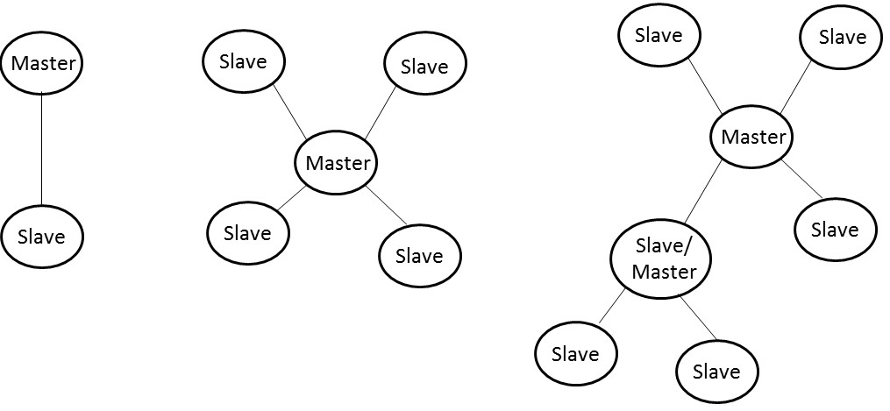
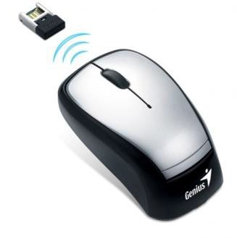
Introducing Bluetooth
When Bluetooth devices detect
one another,
they determine
automatically
whether they need to interact. Each device has a unique Media Access Control (MAC) address which communicating devices can recognise and initialise interaction if required. This process follows three phases:
Discovery - a slave module broadcasts its name and MAC address, seeking for devices to link to.
Pairing - slave and master exchange identification and authentication data, exploring whether a link should be established.
Connecting - initiated by the master, through which a link is finally established.
Example Bluetooth networks

Slide 9

Introducing Bluetooth Low Energy
Bluetooth Low Energy ( BLE, also marketed as Bluetooth Smart ) started as part of the Bluetooth 4.0 Core Specification. It’s tempting to present BLE as a smaller, highly opti‐mized version of its bigger brother, classic Bluetooth, but in reality, BLE has an entirely different lineage and design goals.
Background
Originally introduced under the name Wibree by Nokia in 2006.
Merged into the main Bluetooth standard in 2010 with the adoption of the Bluetooth Core Specification Version 4.0.
The beginning focus was to design a radio standard with the lowest possible power consumption, specifically optimized for low cost, low bandwidth, low power, and low complexity.

Slide 10
What Makes BLE Different?
Compared to other wireless standards, the rapid growth of BLE is relatively easy to explain: BLE has gone further faster because its fate is so intimately tied to the phenomenal growth in smartphones, tablets, and mobile computing.
Key Benefits
low power consumption - Designed for coin cells (15ma peak transmit, 1uA sleep)
Low latency connection (3ms)
Designed to send small packets of data (Connect->transmit->disconnect->sleep)
Small size and low cost
Low bandwidth(~100 kbps)

Slide 11
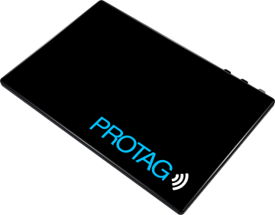
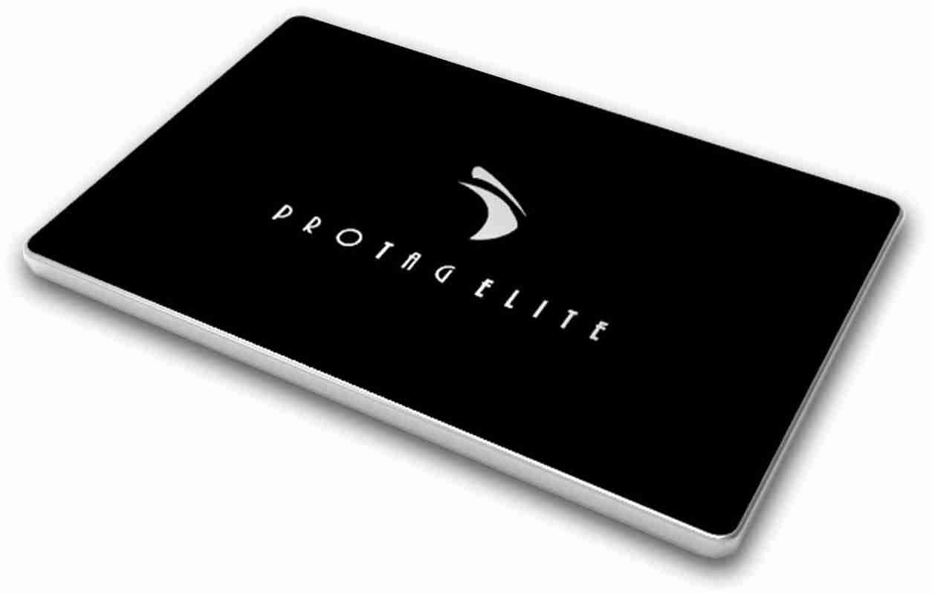
Bluetooth Classic vs SMART
An actual battery-life comparison
Innova’s anti-loss products
vs
Protag G1 (Classic)
Released: 2012
Battery Capacity: 3.7V, 270mAh
Battery Life: 1 - 2 weeks
Protag Elite (SMART)
Released: 2013
Battery Capacity: 3.7V, 150mAh
Battery Life: 6 months to 1 year

Slide 12
Classic Bluetooth vs BLE
Specifications | Bluetooth | BLE(Bluetooth Low Energy)
Network/Topology | Scatternet | Star Bus
Power consumption | Low (less than 30 mA) | Very Low (less than 15 mA)
Speed | 700 Kbps | 1 Mbps
Range | <30 m | 50 meters( 150 meters in open field)
RF Frequency band | 2400 MHz | 2400 MHz
Frequency Channels | 79 channels from 2.400 GHz to 2.4835 GHz with 1 MHz spacing | 40 channels from 2402MHz to 2480 MHz (includes 3 advertising and 37 data channels)
Modulation | GFSK (modulation index 0.35) , π/4 DQPSK, 8DPSK | GFSK (modulation index 0.5)
Latency in data transfer between two devices | Approx. 100 ms | Approx. 3 ms
Spreading | FHSS (1MHz channel) | FHSS (2MHz channel)
Link layer | TDMA | TDMA
message size(bytes) | 358 (Max) | 8 to 47
Error detection/correction | 8 bit CRC(header), 16 bit CRC, 2/3 FEC(payload), ACKs | 24 bit CRC, ACKs
Security | 64b/128b, user defined application layer | 128 bits AES, user defined application layer
Application throughput | 0.7 to 2.1 Mbps | less than 0.3 Mbps
Nodes/Active Slaves | 7 | Unlimited

Slide 13
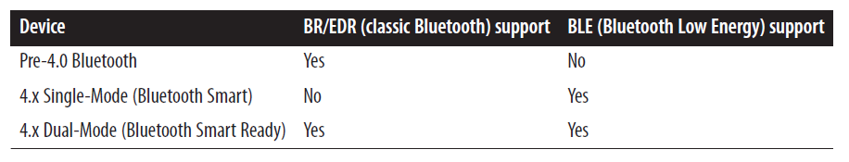
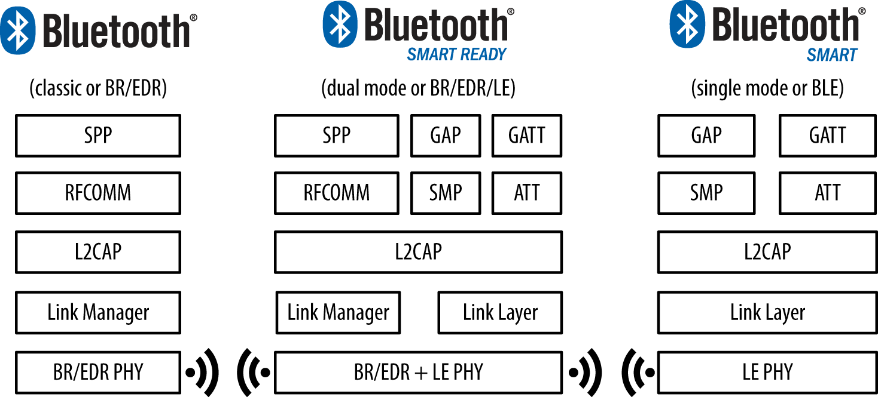
Specification configurations

Slide 14
BLE Platform Support
Support for Bluetooth 4.0 and Bluetooth Low Energy (which is a subset of BT 4.0) is available on most major platforms as of the versions listed below:
iOS5+ (iOS7+ preferred)
Android 4.3+ (numerous bug fixes in 4.4+)
Apple OS X 10.6+
Windows 8 (XP, Vista and 7 only support Bluetooth 2.1)
GNU/Linux Vanilla BlueZ 4.93+

Slide 15
GAP - Generic Access Profile
Protocol Stack
GAP controls connections and advertising in Bluetooth. GAP is what makes your device visible to the outside world, and determines how two devices can (or can't) interact with each other.
Apps
Applications = Profiles & Services
Host
Generic Access Profile
Generic Attribute Profile
Attribute Protocol
Security Manager
Logical Link Control & Adaptation Protocol
Host Controller Interface
Controller
Link Layer
Direct Test Mode
Physical Layer

Slide 16
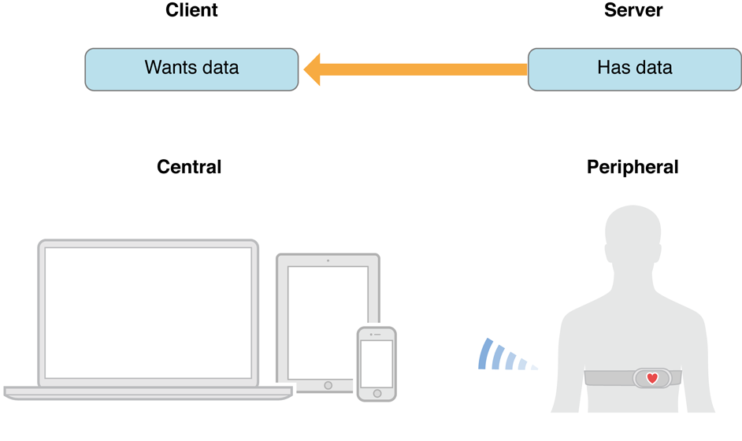
Device role
GAP - Generic Access Profile
GAP defines various roles for devices, but the two key concepts to keep in mind are Central devices and Peripheral devices.
Peripheral devices are small, low power, resource constrained devices that can connect
to a much more powerful central device.
Central devices are usually the mobile phone or tablet that you connect to with far more processing power and memory.

Slide 17
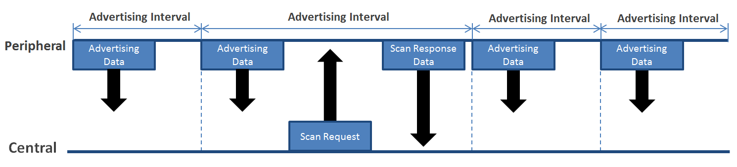
Advertising and Scan Response Data
GAP - Generic Access Profile
There are two ways to send advertising out with GAP. The Advertising Data payload and the Scan Response payload.
Peripheral will set a specific advertising interval, and every time this interval passes, it will
retransmit it's main advertising packet.
If a listening device is interested in the scan response payload (and it is available on the peripheral) it can optionally request the scan response payload, and the peripheral will respond with the additional data.

Slide 18
GATT - Generic Attribute Profile
Protocol Stack
GATT defines the way that two Bluetooth LE devices transfer data back and forth using concepts called Services and Characteristics.
Apps
Applications = Profiles & Services
Host
Generic Access Profile
Generic Attribute Profile
Attribute Protocol
Security Manager
Logical Link Control & Adaptation Protocol
Host Controller Interface
Controller
Link Layer
Direct Test Mode
Physical Layer
It makes use of a generic data protocol called the Attribute Protocol(ATT), which is used to store Services, Characteristics and related data in a simple lookup table using 16-bit IDs for each entry in the table.

Slide 19
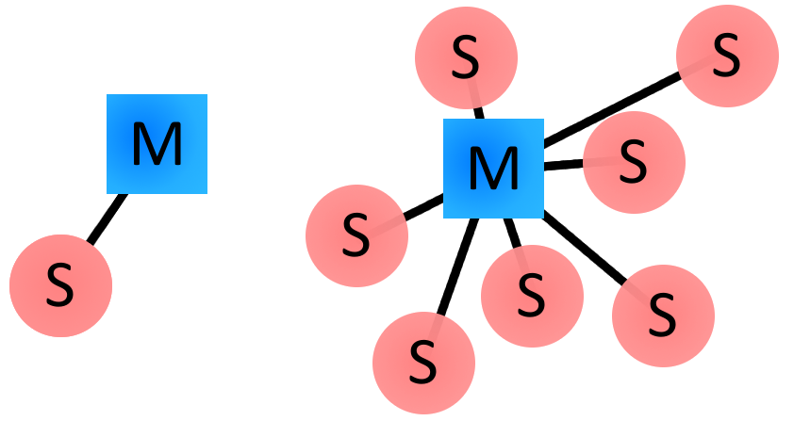
Connected Network Topology
GATT - Generic Attribute Profile
The most important thing to keep in mind with GATT and connections is that connections are exclusive. What is meant by that is that a BLE peripheral can only be connected to one central device (a mobile phone, etc.) at a time!
As soon as a peripheral connects to a central device, it will stop advertising itself and other devices will no longer be able to see it or connect to it until the existing connection is broken.

Slide 20
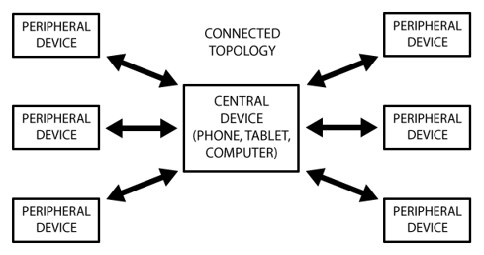
GATT - Generic Attribute Profile
Connected Network Topology
A peripheral can only be connected to one central at a time, but the central device can be connected to multiple peripherals. If data needs to be exchanged between two peripherals, a custom mailbox system will need to be implemented where all messages pass through the central device.
Once a connection is established between a peripherals and central device, however, communication can take place in both directions.

Slide 21
GATT - Generic Attribute Profile
GATT Transactions
The peripheral is known as the GATT Server, which holds the ATT lookup data and service and characteristic definitions, and the GATT Client (the phone/tablet), which sends requests to this server.
All transactions are started by the master device, the GATT Client, which receives response from the slave device, the GATT Server.

Slide 22
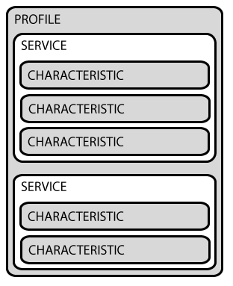
GATT - Generic Attribute Profile
Services and Characteristics
GATT transactions in BLE are based on high-level, nested objects called
Profiles
Services
Characteristics

Slide 23
Services and Characteristics
Profiles A Profile doesn't actually exist on the BLE peripheral itself, it's simple a pre-defined collection of Services that has been compiled by either the Bluetooth SIG or by the peripheral designers.
Services
Characteristics
Note: The example document about the Heart Rate Profile is available on the course website.

Slide 24
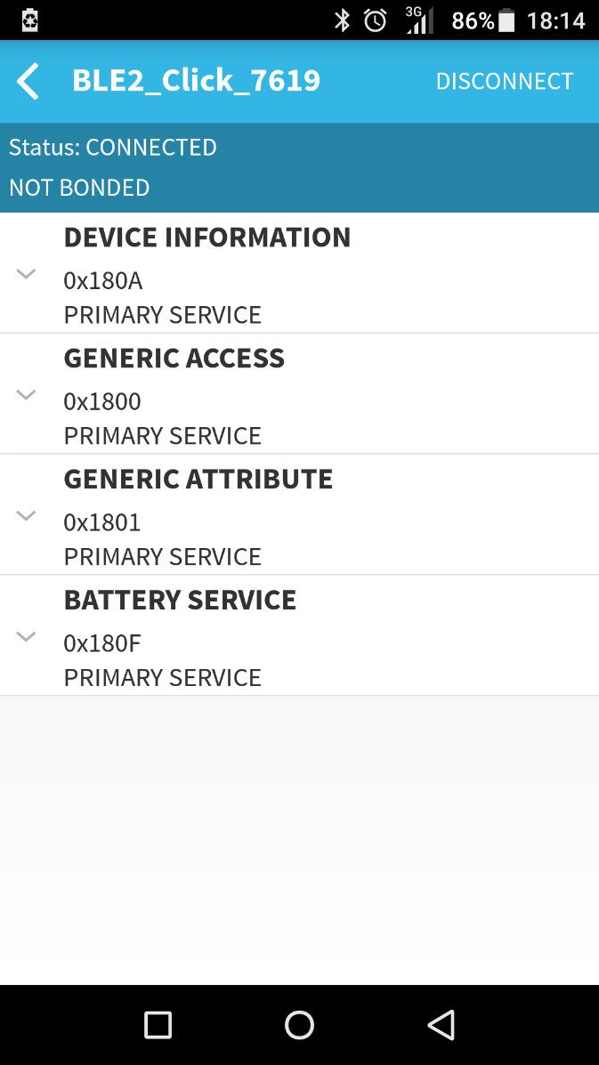
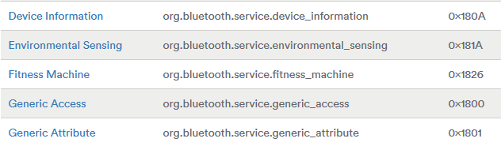
Services and Characteristics
Services Services are used to break data up into logic entities, and contain specific chunks of data called characteristics.
16-bit UUID
A service distinguishes itself from other services by means of a unique numeric ID called a UUID, which can be either 16-bit (official adopted BLE Services) or 128-bit (Customized services).
GATT Services on Bluetooth Technology Website
Service list on BLE2 click

Slide 25
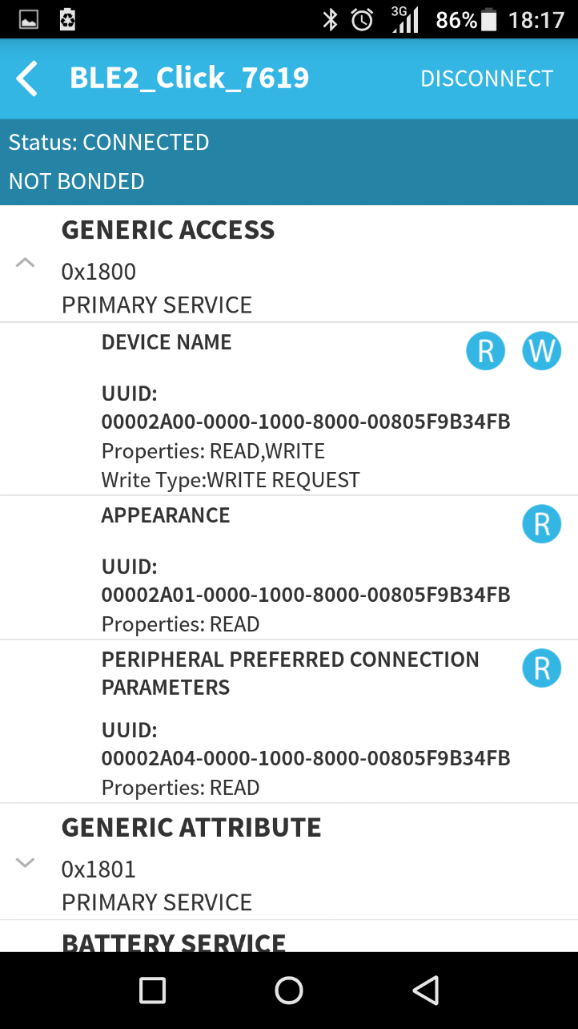
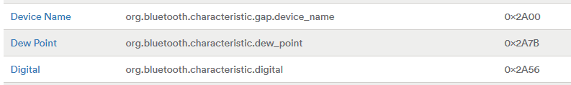
Services and Characteristics
Characteristics The lowest level concept in GATT transactions is the Characteristic, which encapsulates a single data point.
16-bit UUID
Similarly to Services, each Characteristic distinguishes itself via a pre-defined 16-bit or 128-bit UUID.
It may contain an array of related data, for example, the device name.
GATT Characteristics on Bluetooth Technology Website
Characteristic list under the service

Slide 26
An Example of BLE Characteristics
Ref: https://devzone.nordicsemi.com/tutorials/17/
Attribute Handles: row index number in the attribute table.
Attribute Types (UUIDs): 16 or 128-bit value used to identify the type of every attribute.
Example: “Service Declaration” (0x2800), “Characteristic Declaration” (0x2803), “Heart Rate Measurement Characteristic Value” (0x2A37), “Body Sensor Location Characteristic Value” (0x2A38), and “Descriptor Declaration” (0x2902)
Attribute Permissions: define whether an attribute should be readable and/or writeable and what kind of authorization is required.
Attribute Values:
Example 1: Service Declaration attribute: handle (0x000C) the value holds a UUID (0x180D) identifying Heart Rate Services (0X180D).
Example 2: Characteristic Declaration (handle 0x000D) holds information about the subsequent Characteristic Value Declaration (Properties, Handle, and Type); Value at handle (0X000E) with UUID (0x2A37)
Example 3: Characteristic Value Declaration value (handle 0x000E) holds actual heart rate of 167

Slide 28
Property Values
Example: values of Client Characteristic Configuration Descriptor (CCCD) for Heart Rate Characteristic Value Declaration can send notification automatically.

Slide 29
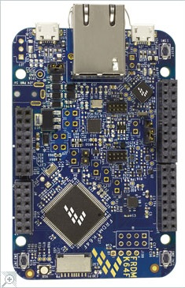
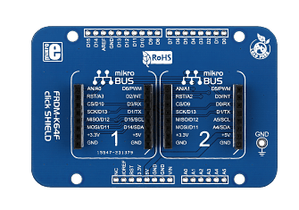
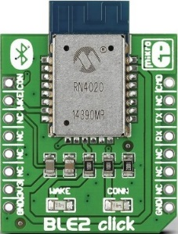
The RN4020 Bluetooth Low Energy Module
The simplest use of the RN4020 module, BLE2 click features the RN4020 module from Microchip, that integrates RF, a baseband controller, and a command API processor. The click communicates with the target board MCU through mikroBUS™ RX, TX and AN (CMD), PWM (con.), and RST (wake) lines. The board is designed to use 3.3V power supply only. And the click shield is used here to connected to K64F.

Slide 30
Simple Bluetooth LE: Receive device info from rn4020(1)
/* Program Example 11.1: Read the device name from the Bluetooth LE.
*/
#include "mbed.h"
#include <string>
Serial rn4020(D1, D0);
Serial pc(USBTX, USBRX);
DigitalOut AWAKE(A3);
InterruptIn list_trigger(SW2);
string buff;
void sendString(string msg);
string getString(void);
string getInfo(void);
char getChar(void);
void D_comm(void);
int main() {
AWAKE = 0;
list_trigger.rise(&D_comm);
rn4020.baud(115200);
wait(1.0); AWAKE = 1; // Enter Command mode
pc.printf("Mode: %s",getString());
sendString("A\r\n"); // Command : Start advertisement
pc.printf("Annotation start: %s",getString());
while(1){
buff = getString();
pc.printf("%s",buff);
if(buff == "Connection End\r\n"){// Restart advertisement after disconnect
pc.printf("Annotation restart\r\n");
sendString("A\r\n");
pc.printf("%s",getString());
}
}
}

Slide 31
Simple Bluetooth LE: Receive device info from rn4020(2)
void sendString(string msg){
rn4020.printf("%s",msg);
}
char getChar(){
return rn4020.getc();
}
string getString(){
string msg = "";
char prev = ' ';
char curr = ' ';
while(1){
if(rn4020.readable()){
prev = curr;
curr = getChar();
msg += curr;
if(prev=='\r' and curr=='\n'){// check if reach the end
break;
}
}
}
return msg;
}

Slide 32
Simple Bluetooth LE: Receive device info from rn4020(2)
string getInfo(){
string msg = "";
char prev = ' ';
char curr = ' ';
int line = 0;
while(1){
if(rn4020.readable()){
prev = curr;
curr = getChar();
msg += curr;
if(prev=='\r' and curr=='\n'){
line = line + 1;
if(line == 6) // D command return 6 line
break;
}
}
}
return msg;
}
void D_comm(){
AWAKE = 0;
wait(1.0);
AWAKE = 1; // Enter CMD mode
pc.printf("Mode: %s",getString());
sendString("D\r\n");
pc.printf("%s",getInfo()); // Dump information about device
}

Slide 33
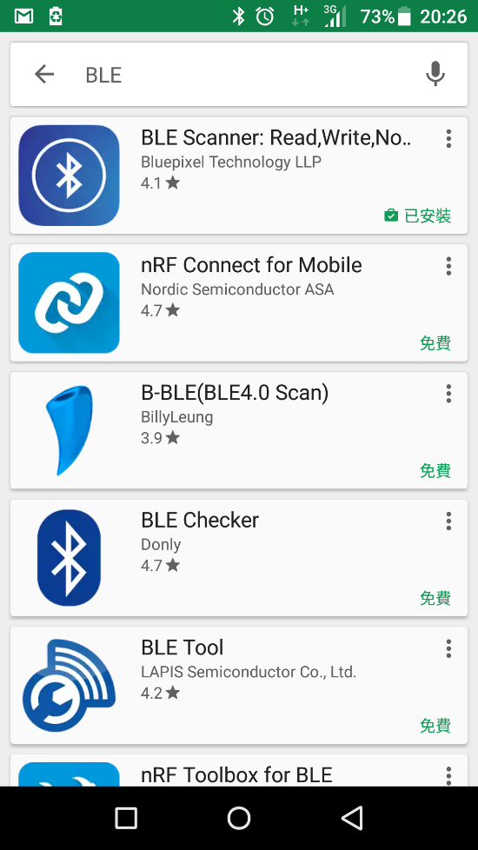
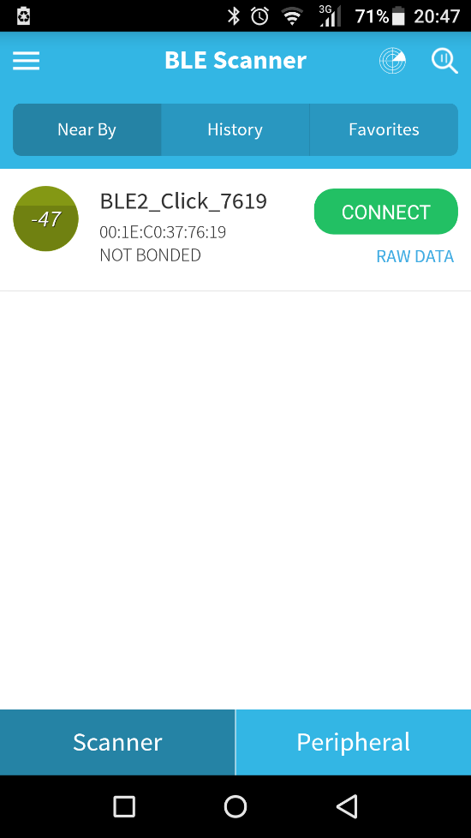
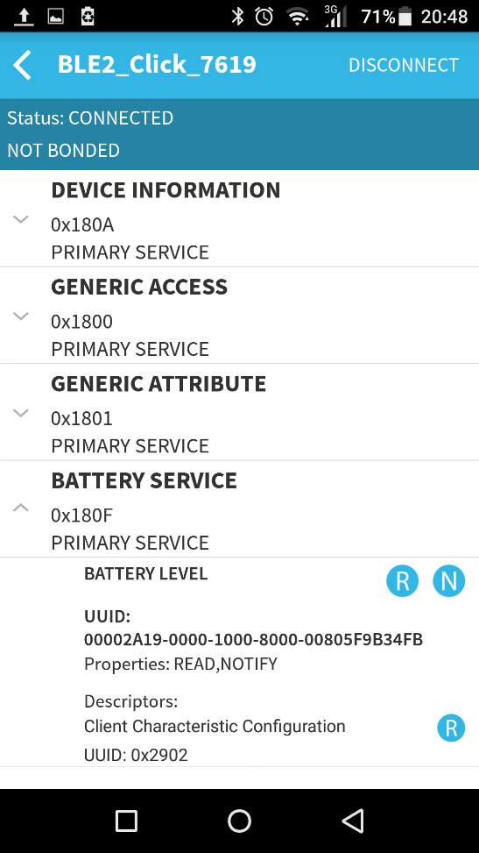
Simple Bluetooth LE: Receive device name from rn4020(3)
After start the advertisement, we could use smart phone with BLE app to scan rn4020 on both Android and iOS platform. We take the android platform as an example.
Installing the app on smart phone
Scanning the advertising device
Connect to the device

Slide 34
Simple Bluetooth LE: Reading battery level and Notification
#include "mbed.h"
#include <string>
Serial rn4020(D1, D0);
Serial pc(USBTX, USBRX);
DigitalOut led(LED_GREEN);
DigitalOut AWAKE(A3);
InterruptIn sw2(SW2);
InterruptIn sw3(SW3);
string buff;
void init_ble(void);
void sendString(string msg);
string getString(void);
char getChar(void);
void battery50(void){//update value with handle
sendString("SHW,0018,32\r\n");
pc.printf("Write handle = 0x0018: %s",getString());
}
void battery30(void){//update value with UUID
sendString("SUW,2A19,1E\r\n");
pc.printf("Wirte to UUID = 2A19: %s",getString());
}

Slide 35
Simple Bluetooth LE: Reading battery level and Notification(2)
int main() {
AWAKE = 0;
sw2.rise(&battery30); // Update battery with interrupt input sw2
sw3.rise(&battery50); // Update battery with interrupt input sw3
rn4020.baud(115200);
wait(1.0);
init_ble();
AWAKE = 1; // Enter Command mode
pc.printf("CMD mode: %s",getString());
sendString("A\r\n"); // Command : Start advertisement
pc.printf("Annotation start: %s",getString());
while(1){
buff = getString();
pc.printf("%s",buff);
if(buff == "Connection End\r\n"){
pc.printf("Annotation restart\r\n");
sendString("A\r\n"); "){// Restart advertisement after //disconnect
pc.printf("%s",getString());
}
}
}

Slide 36
Simple Bluetooth LE: Reading battery level and Notification(3)
void init_ble() { // Initialize rn4020
AWAKE = 1;
pc.printf(" CMD mode :%s",getString());
wait(0.1);
sendString("SF,1\r\n");
pc.printf("Set to factory default configuration:%s",getString());
wait(0.1);
sendString("SS,C0000000\r\n");
pc.printf("Enable support of the Device Information and Battery services: %s",getString());
wait(0.1);
sendString("SR,00000000\r\n");
pc.printf("Peripheral mode: %s",getString());
wait(0.1);
sendString("R,1\r\n");
pc.printf("%s",getString()); AWAKE = 0;
}

Slide 37
More about Bluetooth LE :
Private Service
Connect two mbed with Bluetooth Low Energy
BLE programing on Linux
from bluepy.btle import Scanner, DefaultDelegate
class ScanDelegate(DefaultDelegate):
def __init__(self):
DefaultDelegate.__init__(self)
def handleDiscovery(self, dev, isNewDev, isNewData):
if isNewDev:
print "Discovered device", dev.addr
elif isNewData:
print "Received new data from", dev.addr
scanner = Scanner().withDelegate(ScanDelegate())
devices = scanner.scan(10.0)
for dev in devices:
print "Device %s (%s), RSSI=%d dB" % (dev.addr, dev.addrType, dev.rssi)
for (adtype, desc, value) in dev.getScanData():
print " %s = %s" % (desc, value)

Slide 38
Evaluating Bluetooth LE & Bluetooth
Bluetooth LE & Bluetooth are the exciting technology that allows short range wireless communication. They have many valuable applications where wires are intrusive, expensive or difficult to install.
Recent enhancements to Bluetooth have enabled streaming of high quality audio data and increased range, so the opportunities and applications for Bluetooth are continuously growing.
Bluetooth Low Energy is intended for low power applications. It is interesting to note that some mbed enabled boards have this capability, and there is support information on the mbed web site

Slide 39
Chapter Review
Wireless links exploit the characteristics of the electromagnetic spectrum,
notably in radio, infra-red or visible light.
A wide range of protocols and technologies exist to implement wireless links across personal, local, neighbourhood and wide area networks.
Bluetooth is a complex yet effective protocol defined within the IEEE 802 group, which allows Bluetooth-enabled devices to connect and transfer data wirelessly, with potentially high data rates.
The RN4020 module can be used to give an mbed Bluetooth LE capability.

